Slide 1
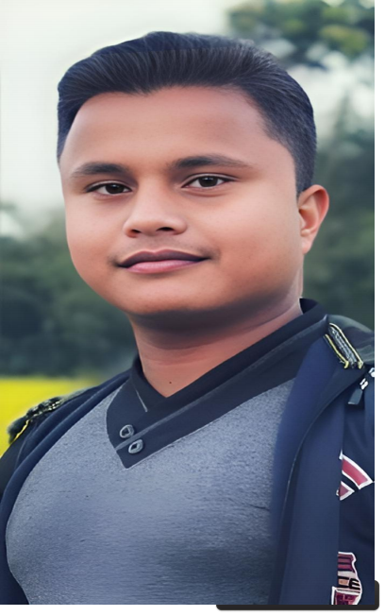

My Name and Biography
[MD. ABUBAKKOR SIDDIK]
By Md Abubakkor Siddik
Page 01

Slide 2
Early Life and Upbringing
My childhood memories are very close to my heart and make me smile on my difficult days. Perhaps the time I remember very fondly was going to swimming classes.Hole my childhood I spent in my village name Dublia, upazila: Khansama , District :Dinajpur
I'm from a urban Area. My family always stay in my village.Becouse of our life dependent in
Agriculture.Soetimes I visit field with my father.
Page 02

Slide 3




Education and
Achievements
1 3 | Bachelor's Degree [Nilphamari Govt. College in Economics, graduating with honors.] Awards and Recognition I get a lot of awards/ recognition for my Good result and my teaher really appreciates me for my result but gave me second lowest rating in my annual review.
Master's Degree
[Nilphamari Govt. College in Economics. Focusing on International Economics.]
2
Page 03

Slide 4


Professional Career
1
Early Career
I work with our clients to help them create best-in-class early careers programmes, equitable assessment frameworks and compelling, inclusive .My company name is IT creation
Mid-Career
At MMCL I'll find career stories, helpful tips, and to successlots of inspiration fully navigate my
mid-career life as my transform from “junior rockstar”
2
3
Present
During my position as a data analys in MSL
company I've completed many tasks and
projects that provide valuable data for the
leadership team in my company.Now I currently work here.
Page 04

Slide 5
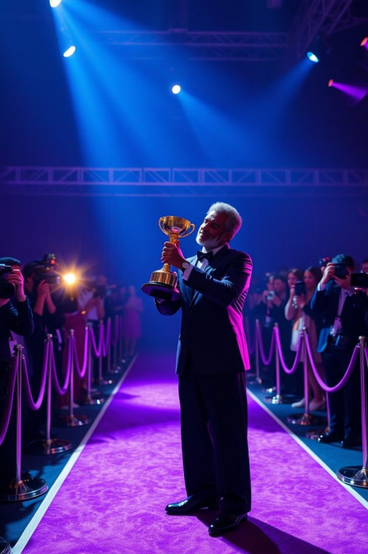
Notable Accomplishments
and Awards
Published Book
I wrote a book name
Somoyet Golpo.It published two month ago.It's the most famous book of time management.
Industry Recognition
Awarded best seller for
most demanding books , recognized as a
leader in Ekushe boi mela.
Impactful Project Led the development of manging time achieving excellent result and positively impacting the society for education.
Page 05

Slide 6
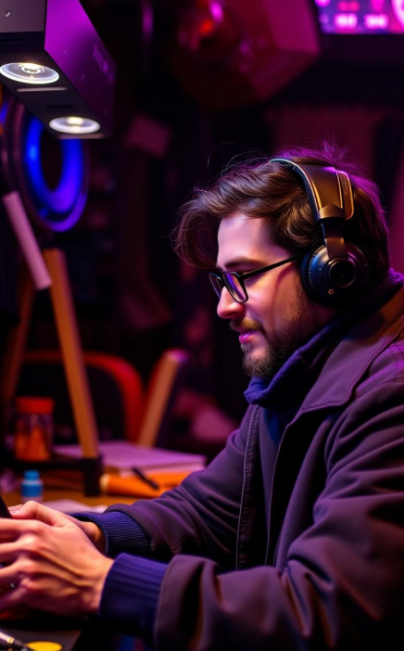



Personal Interests and
Hobbies
Reading
Because reading is
something that molds you and adds to your character. Each triumph, lesson and
pivotal moment of the
protagonist becomes your own. Every ache, pain and harsh truth becomes yours to bear.
Travel
My first unorganized trip overseas was back in January of 2023.
It was a 9 week backpacking trip through Southeast Asia, and it changed my whole perception of the word travel. Growing up, backpackers were fiictional characters from books and movies (I’m thinking of you Leonardo Dicaprio from “The Beach”).
Sports
My favourite sport is cricket.In conclusion, cricket is my favorite sport because of
its blend of skill, strategy, and teamwork.
It keeps me engaged, active, and fresh.
motivated.
Page 06

Slide 7



Impact on Community and Society
Community Involvement
I tutor adults in math in preparation for them taking the
GED exam. I do this through the county library system.
1
Mentorship and Guidance
As a Mentors, I guide and support others to help them grow in their careers and lives. They share their knowledge and experiences, providing advice and feedback to help the me achieve their goals.
2
Advocacy and Change
Advocates are people within an organization who have serious ideas about what must change but wield no institutional power or resources to make the change happen. They are people in search of a sponsor.
3
Page 07

Slide 8
Lessons Learned and Legacy
1
Persistence and Determination
Perseverance is the ability to keep going and stay focused on my goals, even when faced with challenges. It's an important skill that can help me achieve my goals, develop resilience, and grow.
2
Value of Collaboration
Working with a team to come up with ideas or solutions to a problem.Keeping an open line of communication between management and employees.
3
Passion and Purpose
My purpose in life is to explore my potential and personality to the extreme in all aspects of life.
Page 08

Slide 9

Conclusion: Key Takeaways
1
Passion
I found my passion to be a journalist in the first grade. Most individuals don't even know what they want to be at that age.
2
Purpose
My purpose in life is to live a life devoid of regrets. To look back at life one day and be assured that I gave my best in everything I did.
3
Impact
My Impact is international project aiming at strengthening the belief among Gen Z members that they really do have an impact on the real world and can act to change it if needed. We want to give a sense of empowerment to young people and highlight their actions.
Page 09

Slide 10






1
Social media Profile
Https://www.facebook.com/abubakkorsiddik
2
Https://www.x.com/abs99
I have many social media profiles.Here I give some of this.
3
Https://www.github.com/abubakkor-abs
4
Https://www.linkedln.com/abubakkor99
5
Https://www.instagram.com/abubakkorsiddik9
6
Https://www.youtube.com/abschannel
Page 10

Slide 11
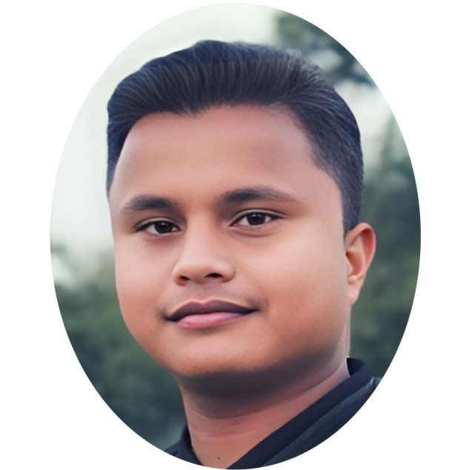

Thanks for Watching my presentation
Presented By Md Abubakkor Siddik
EDGE ICT Training Batch-30
Page 11

